Slide 1
Focal and Global Knowledge Distillation for Detectors CVPR 2022
Zhendong Yang
Xiaohu Jiang
Zehuan Yuan
Chun Yuan
Zhe Li
Yuan Gong
Danpei Zhao

Slide 2
Outline
Introduction
Related Work
Method
Experiment
Conclusion

Slide 3
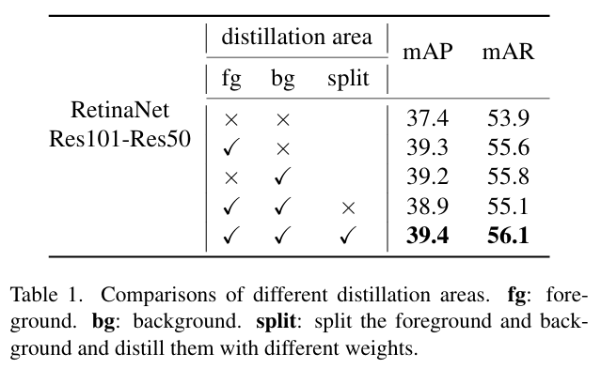
Background
For object detection, extreme foreground-background class imbalance is not only a key point but also a challenge
If we do KD on foreground and background evenly, then we’ll get a worst result compared to only do KD on foreground or background

Slide 4
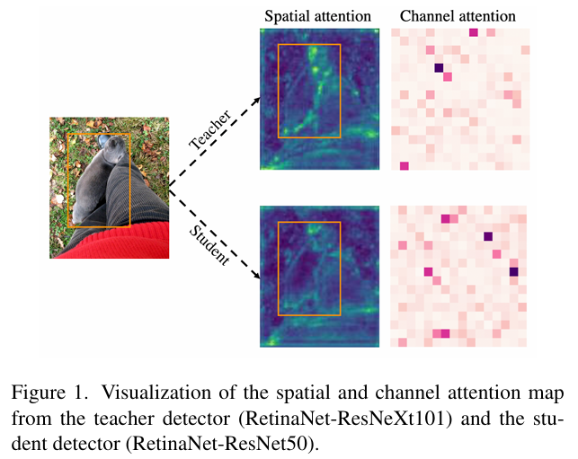
Background
Besides, the attention in foreground of teacher and student are quite different while that in background is relatively small

Slide 5
Abstract
Introduce FGD, a new method can be used directly on various detectors
Achieve SOTA on COCO dataset on multiple methods

Slide 6
Outline
Introduction
Related Work
Method
Experiment
Conclusion

Slide 7
Object Detection
Two-stage detectors [1, 8, 22]
Firstly, use RPN to find the areas possibly have the object
Then send each candidate areas into R-CNN head to classify and regress
Can achieve better result but cost more time

Slide 8
Object Detection
One-stage Anchor-based detectors [17, 19, 21]
Get the classification and bounding box on feature map directly
Set huge amount of anchor boxes on feature map in advanced
Each box will predict the class and coordinate of object
Since # anchor boxes >> # real object, it brings extra computation and may intensify the imbalance of positive and negative class

Slide 9
Object Detection
One-stage Anchor-free detectors [6, 26, 32]
Show a way to predict the key point and location of targets directly
Has simpler structure and smaller amount of computation
Newest method compared to previous two

Slide 10
Knowledge Distillation
First proposed by Hinton et al. [11], which soften the teacher model output to transfer the dark knowledge to student model
FitNet [23] proves that the semantic information from intermediate layers from teacher model is also helpful to guide the student model
Chen et al. [3] first apply knowledge distillation to detector by distilling knowledge on neck feature, classification head and regression head

Slide 11
Knowledge Distillation
SENet [13] and CBAM [30] show that focusing on crucial pixels and channels helps CNN-based model get better results
Zagoruyko et al. [34] use a simply way to get the spatial attention mask and improve the performance of distillation

Slide 12
Knowledge Distillation
FGFI [28] and TADF [25] use the fine-grained and Gaussian Mask to select the distillation area, respectively
GID [5] distills the areas where the performance of student and teacher is different
FKD [35] uses attention masks and Non-local module [29] to guide the student and distills the relation, respectively

Slide 13
Outline
Introduction
Related Work
Method
Experiment
Conclusion

Slide 14
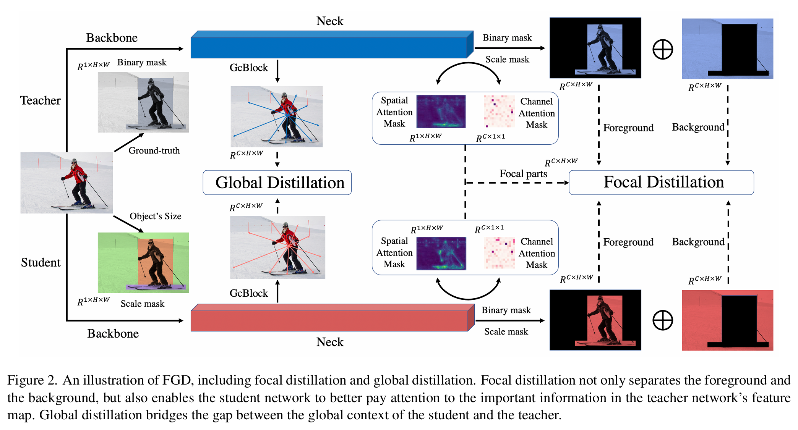
Structure Illustration

Slide 15
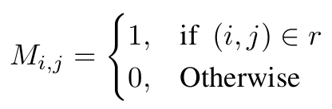
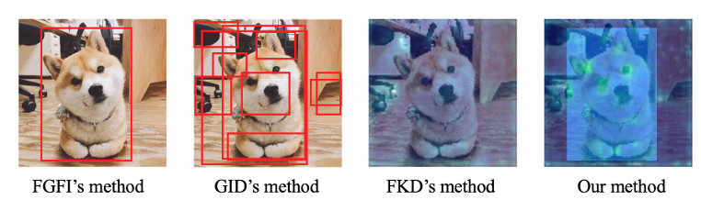
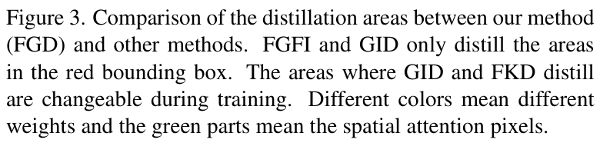
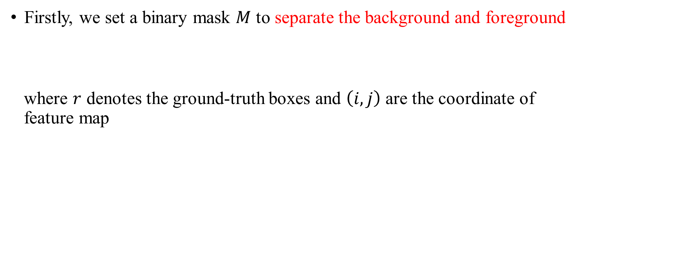
Focal Distillation
Firstly, we set a binary mask $M$ to separate the background and foreground
where $r$ denotes the ground-truth boxes and $\left(i, j\right)$ are the coordinate of feature map

Slide 16
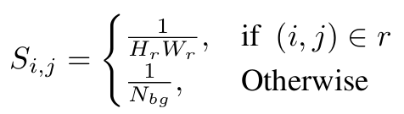
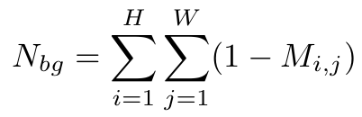
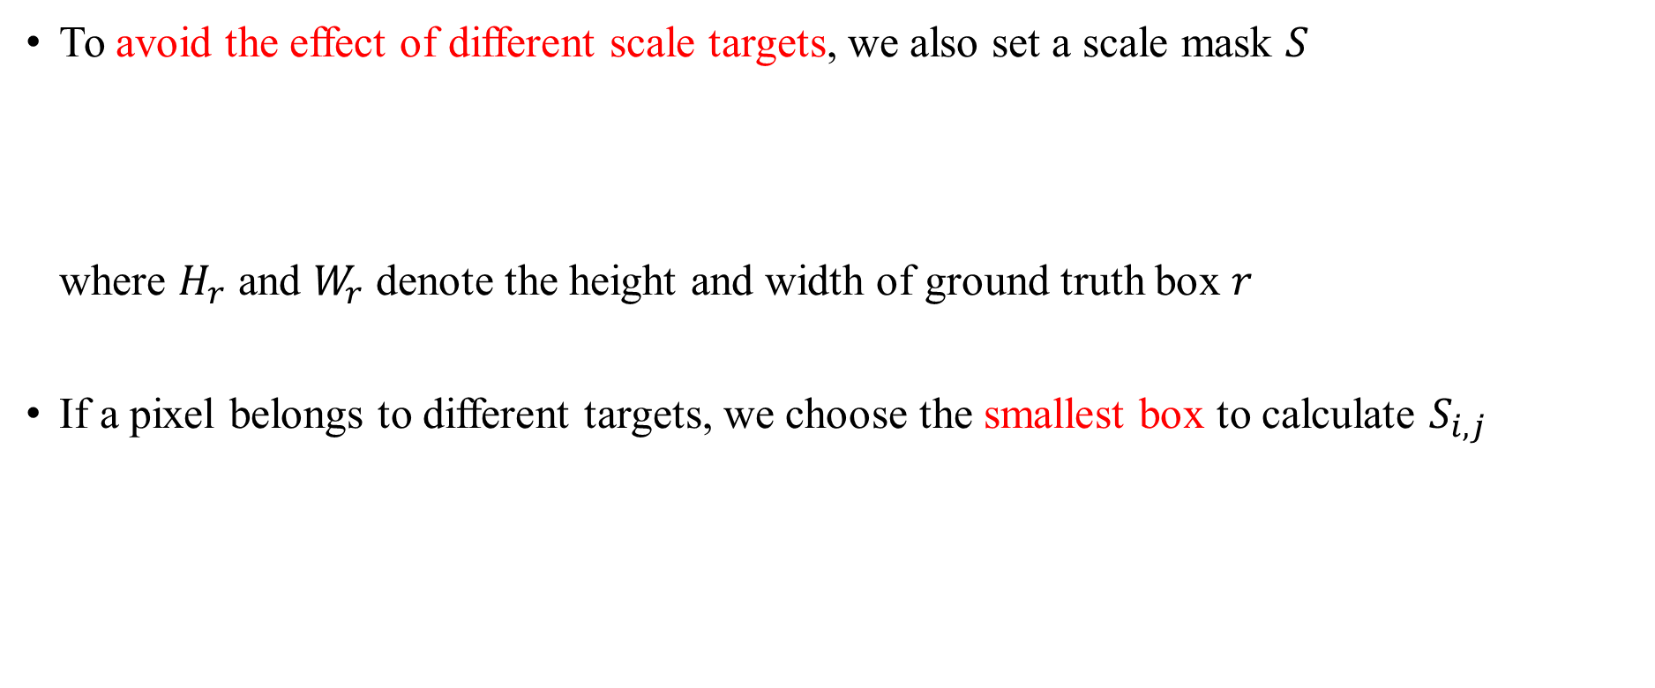
Focal Distillation
To avoid the effect of different scale targets, we also set a scale mask $S$ where $H_{r}$ and $W_{r}$ denote the height and width of ground truth box $r$
If a pixel belongs to different targets, we choose the smallest box to calculate $S_{i, j}$

Slide 17
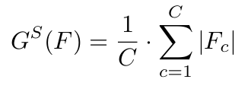
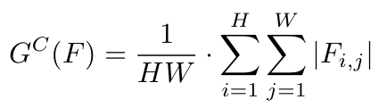
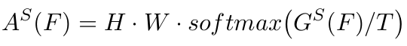
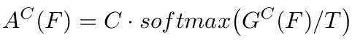
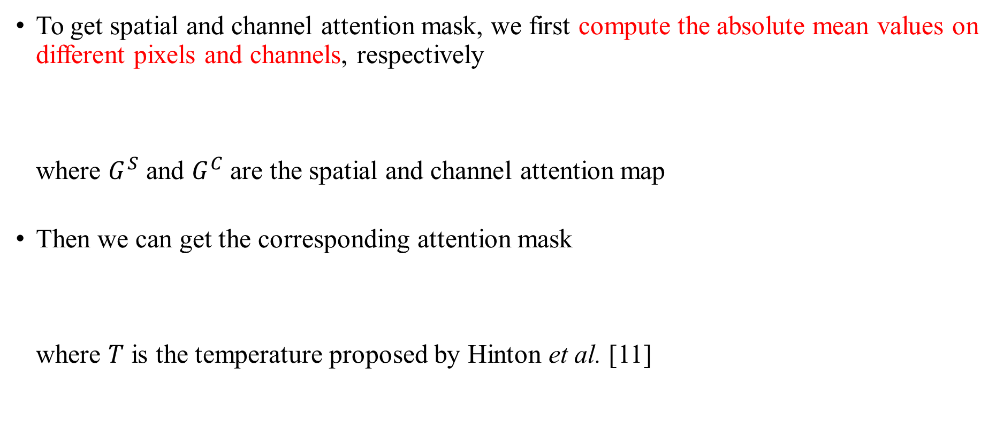
Focal Distillation
To get spatial and channel attention mask, we first compute the absolute mean values on different pixels and channels, respectively where $G^{S}$ and $G^{C}$ are the spatial and channel attention map
Then we can get the corresponding attention mask where $T$ is the temperature proposed by Hinton et al. [11]

Slide 18
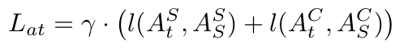
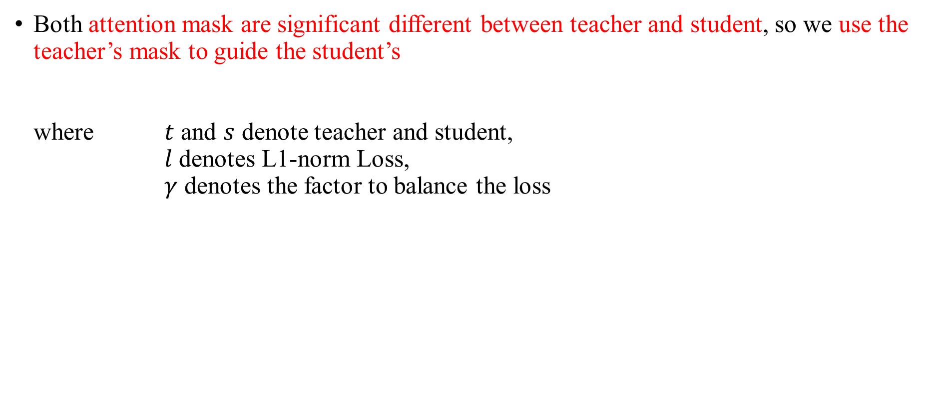
Focal Distillation
Both attention mask are significant different between teacher and student, so we use the teacher’s mask to guide the student’s where $t$ and $s$ denote teacher and student, $l$ denotes L1-norm Loss, $γ$ denotes the factor to balance the loss

Slide 19
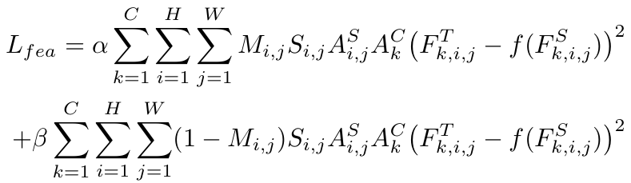
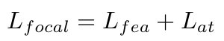
Focal Distillation
With all masks, we can finally calculate the loss of feature and Focal Distillation

Slide 20
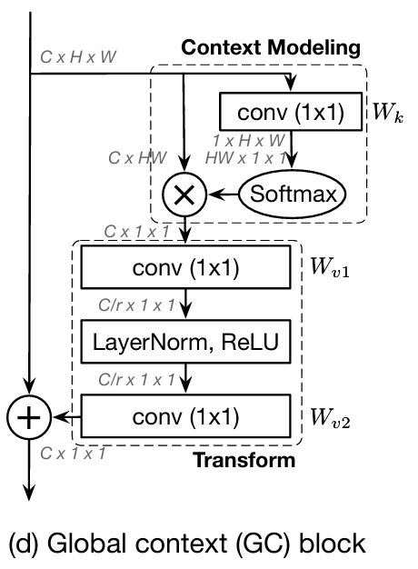
Global Distillation
We first use GcBlock [2] to capture the global relation information in a single image

Slide 21
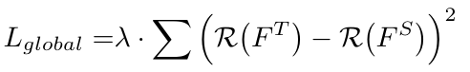
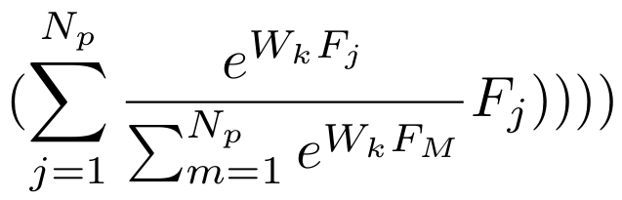
Global Distillation
After capturing the global information, we can calculate the loss of Global Distillation

Slide 22
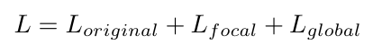
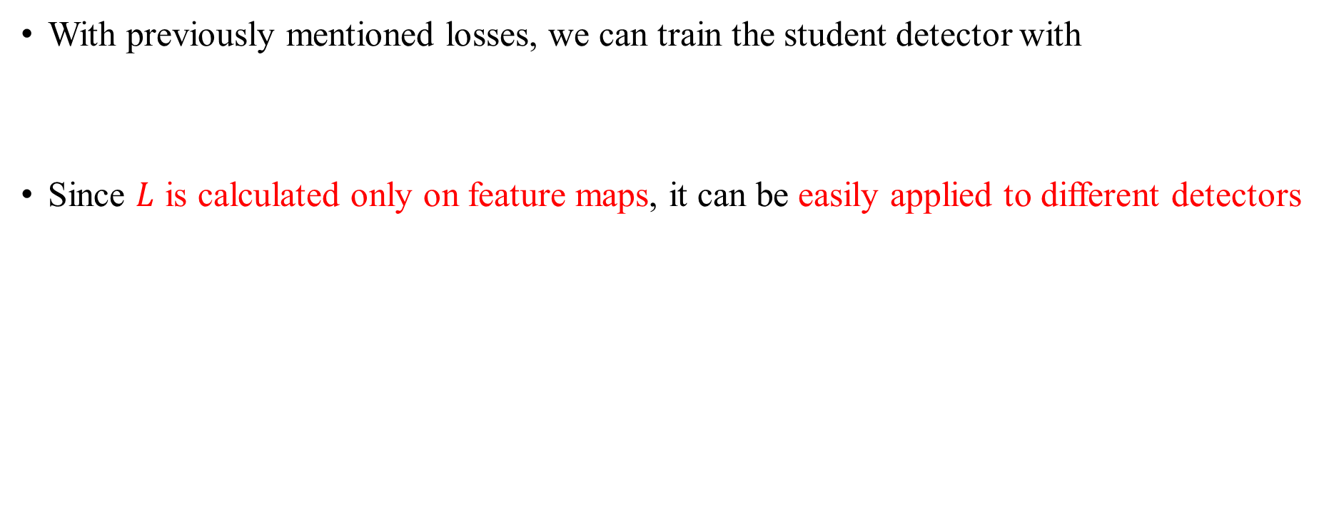
Overall Distillation
With previously mentioned losses, we can train the student detector with
Since $L$ is calculated only on feature maps, it can be easily applied to different detectors

Slide 23
Outline
Introduction
Related Work
Method
Experiment
Conclusion

Slide 24
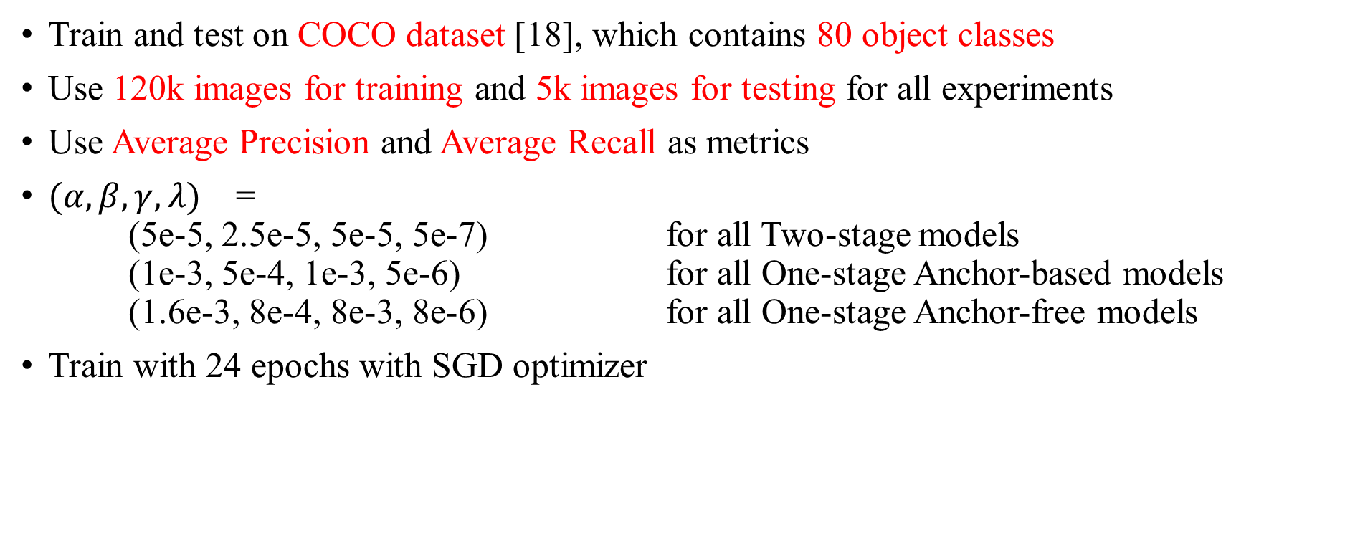
Setting
Train and test on COCO dataset [18], which contains 80 object classes
Use 120k images for training and 5k images for testing for all experiments
Use Average Precision and Average Recall as metrics
$(α, β, γ, λ)$ = (5e-5, 2.5e-5, 5e-5, 5e-7) for all Two-stage models (1e-3, 5e-4, 1e-3, 5e-6) for all One-stage Anchor-based models (1.6e-3, 8e-4, 8e-3, 8e-6) for all One-stage Anchor-free models
Train with 24 epochs with SGD optimizer

Slide 25
Experiment 1
Conduct experiments on Two-stage model: Faster RCNN One-stage Anchor-based model: RetianNet One-stage Anchor-free model: FCOS
Compared with FGFI [28] and GID [5]
Teacher model is ResNet-101 and student model is RestNet-50 [9]

Slide 26
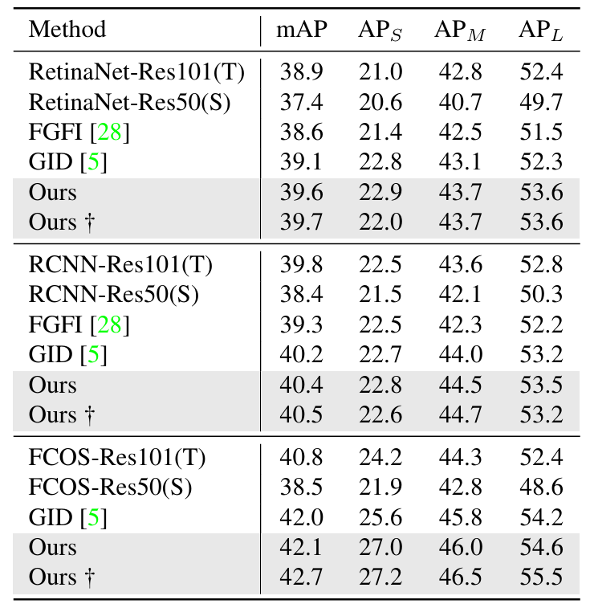
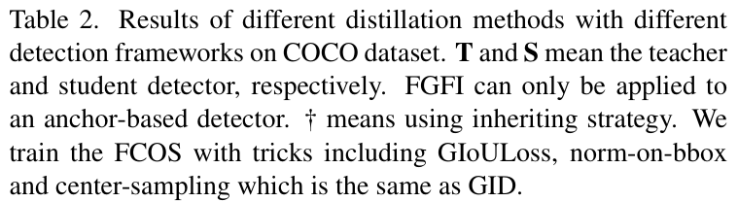
Experiment 1

Slide 27
Experiment 2
Conduct experiments between heterogeneous backbones
Teacher model is ResNeXt101
Student model is ResNet-50
Compared with FKD [28]

Slide 28
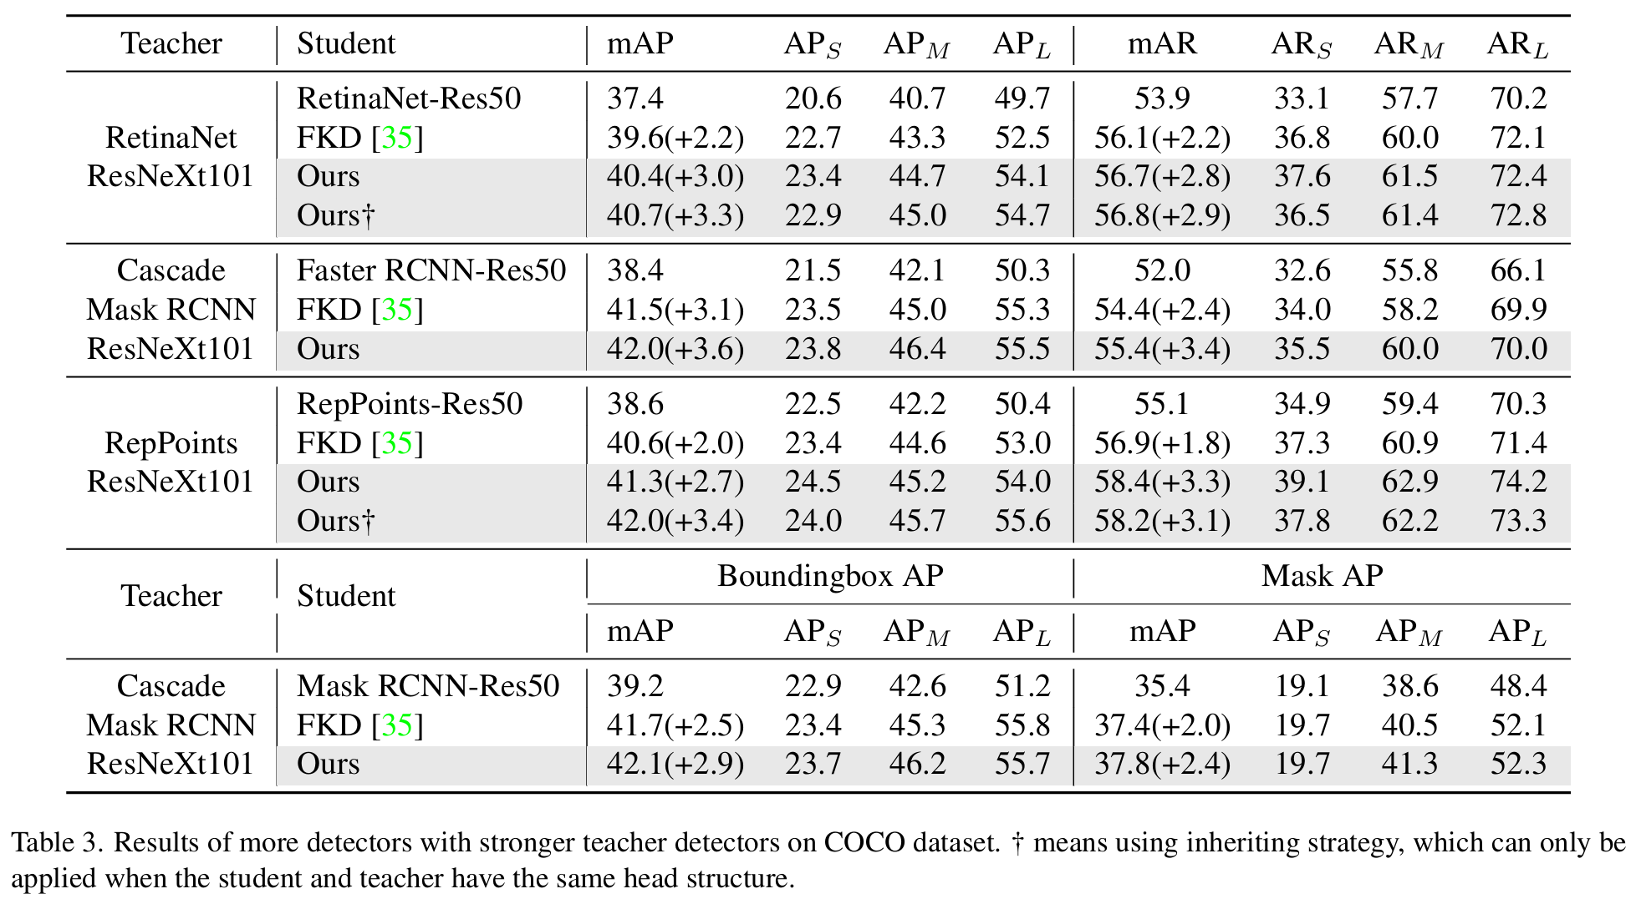
Experiment 2

Slide 29
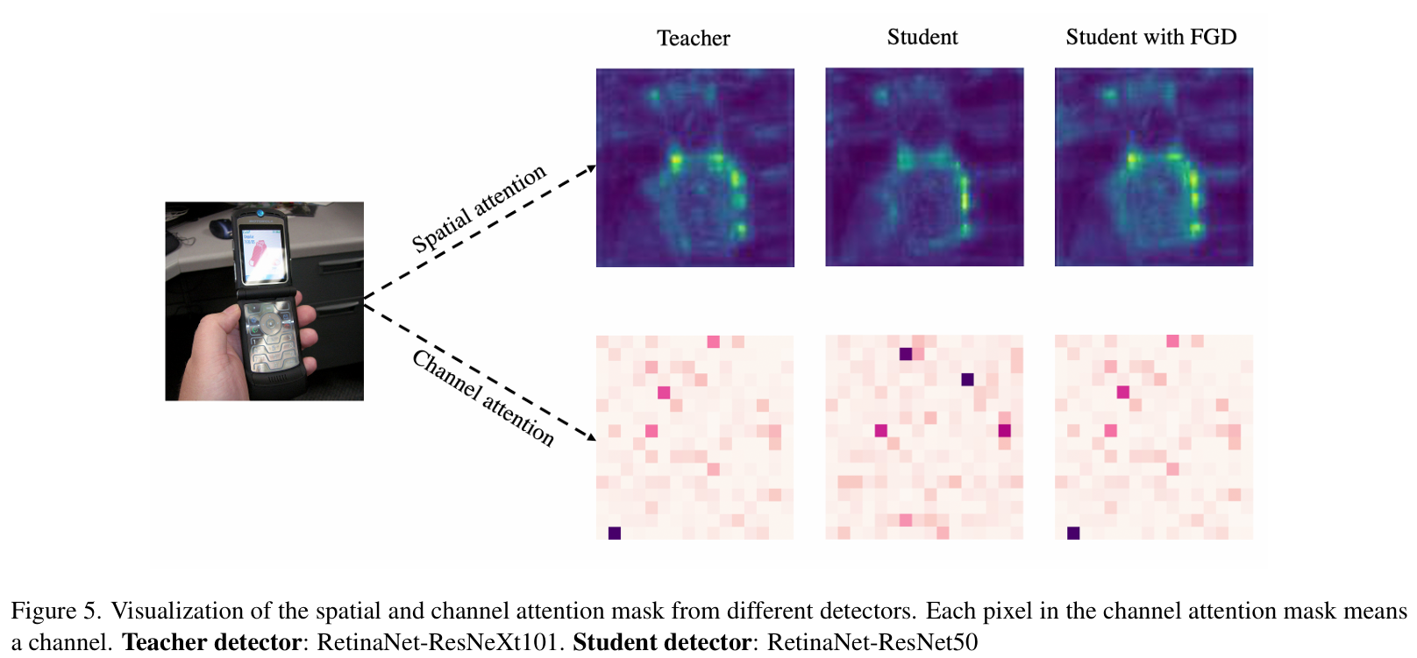
Experiment 2

Slide 30
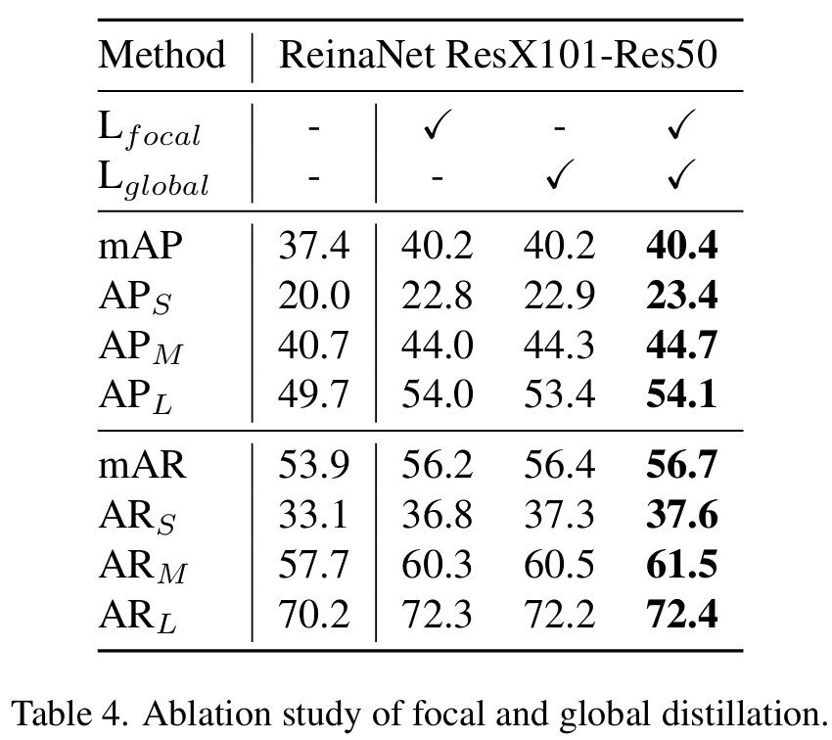
Ablation 1
Investigate the influences of Focal Loss and Globa Loss
They find Focal Loss benefits more to the large size targets and Global Loss benefits more to the small and medium targets

Slide 31
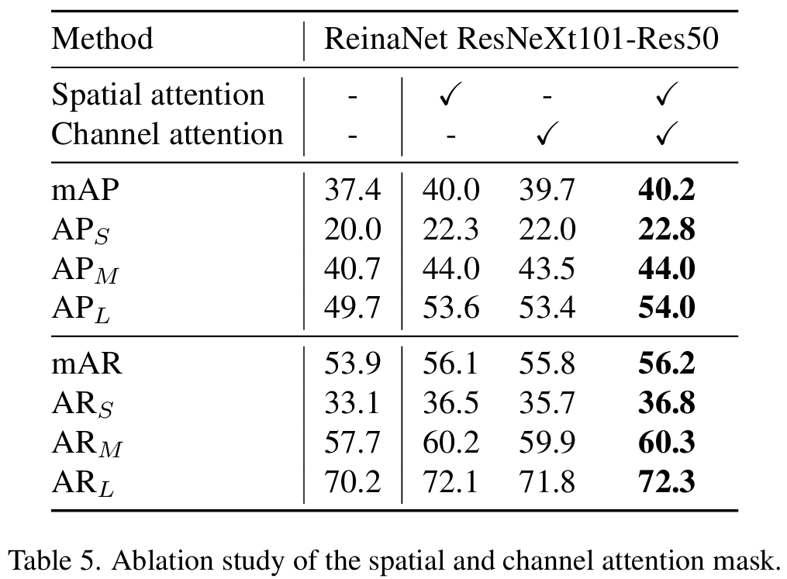
Ablation 2
Investigate the influences of spatial attention and channel attention

Slide 32
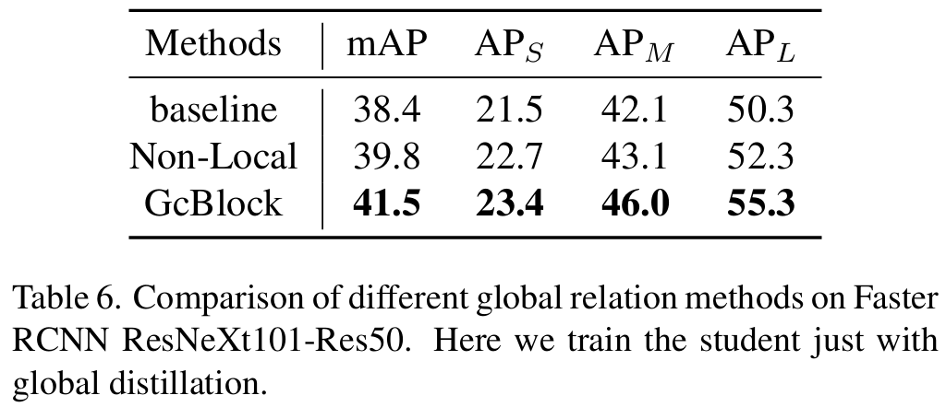
Ablation 3
Investigate the influences of GcBlock [2]
Replace with Non-local module [29]

Slide 33
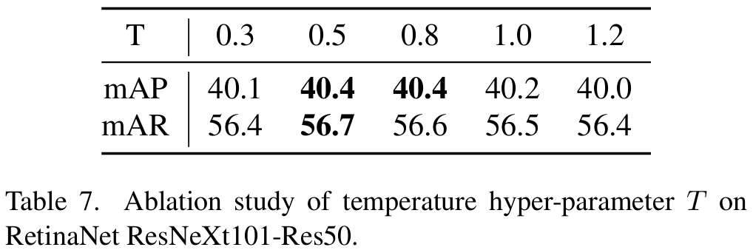
Ablation 4
Investigate the influences of temperature

Slide 34
Outline
Introduction
Related Work
Method
Experiment
Conclusion

Slide 35
Conclusion
Point out the student detector needs to pay attention to both the crucial part and global relations from teacher
Propose Focal and Global Distillation (FGD) to guide the student detector
Prove FGD can be used on different types of detector by experiments
Show it can bring improvement by initializing student’s parameters be like teacher’s

Slide 36
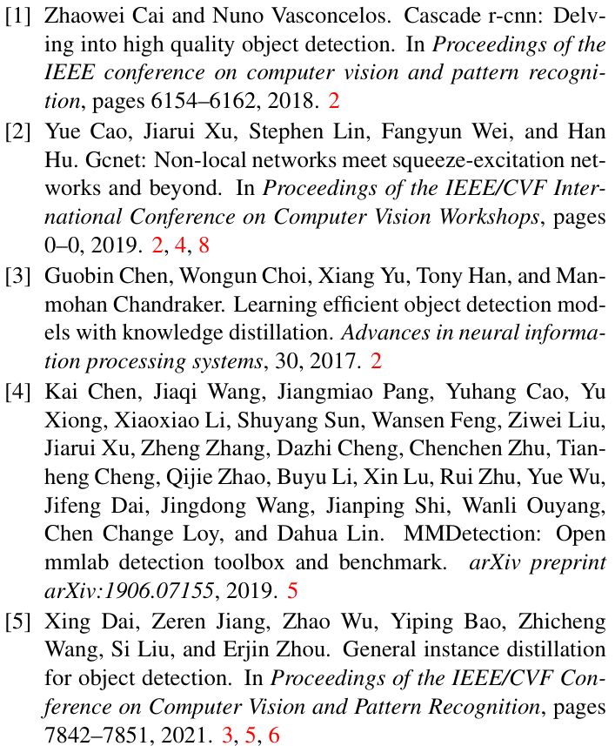
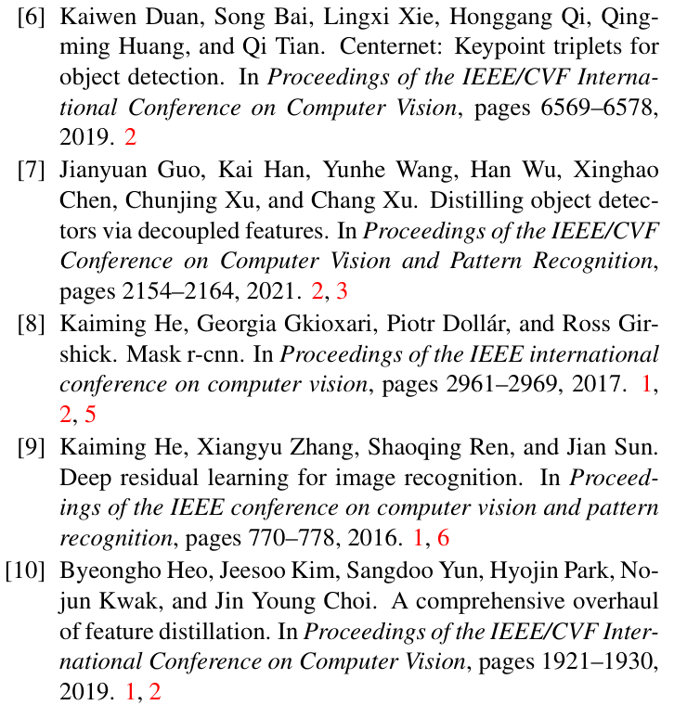
Reference

Slide 37
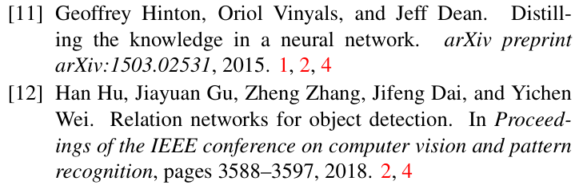
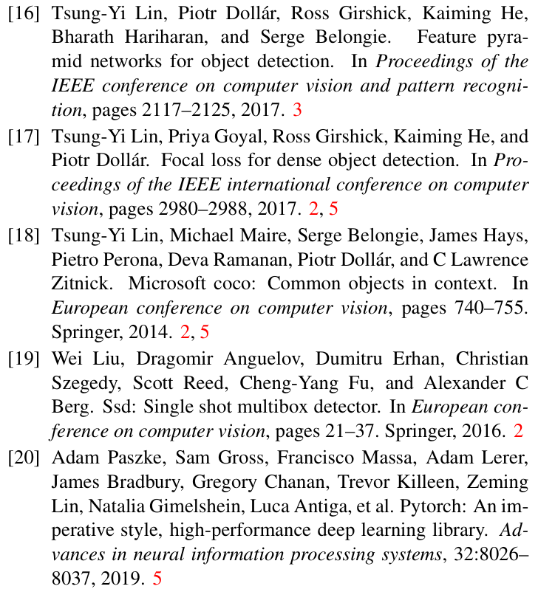
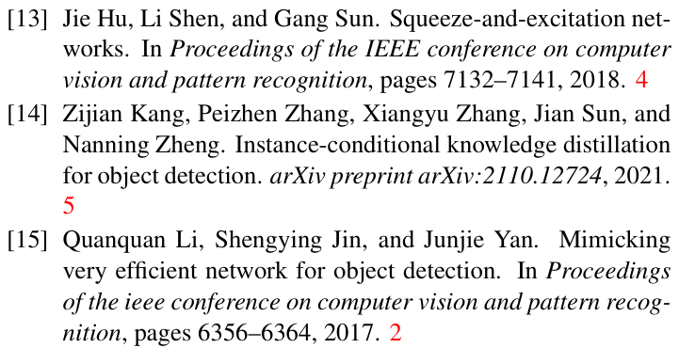
Reference

Slide 38
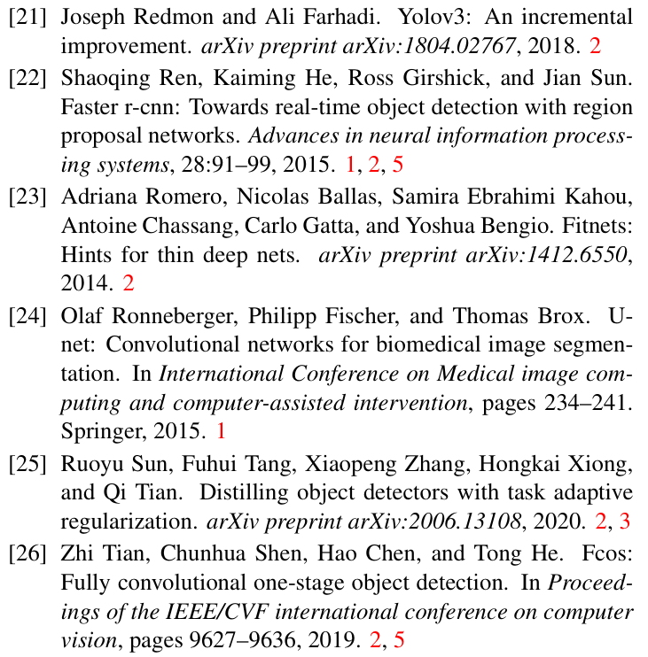
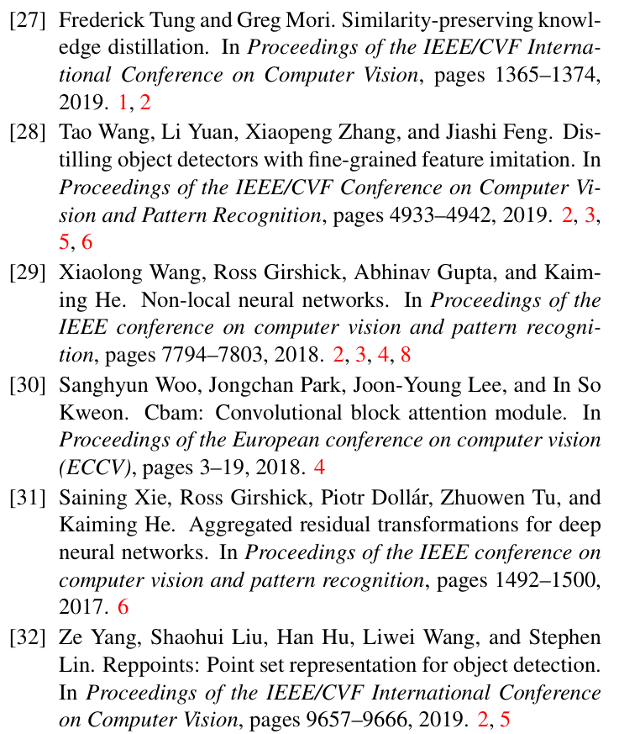
Reference

Slide 39
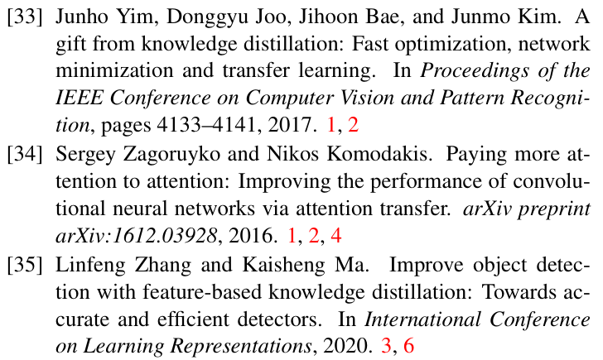
Reference

